Slide 1
Classification : Decision Tree
Decision Trees are a popular supervised machine learning algorithm used for both classification and regression tasks. They work by learning simple decision rules inferred from the data features to predict a target label.
A Decision Tree is structured as a tree where each node represents a decision based on a feature of the data, and each branch represents an outcome of that decision.
The root node is the topmost node, representing the first decision.
The internal nodes are decision points, splitting based on feature values.
Leaf nodes are the endpoints representing the final prediction or output.

Slide 2
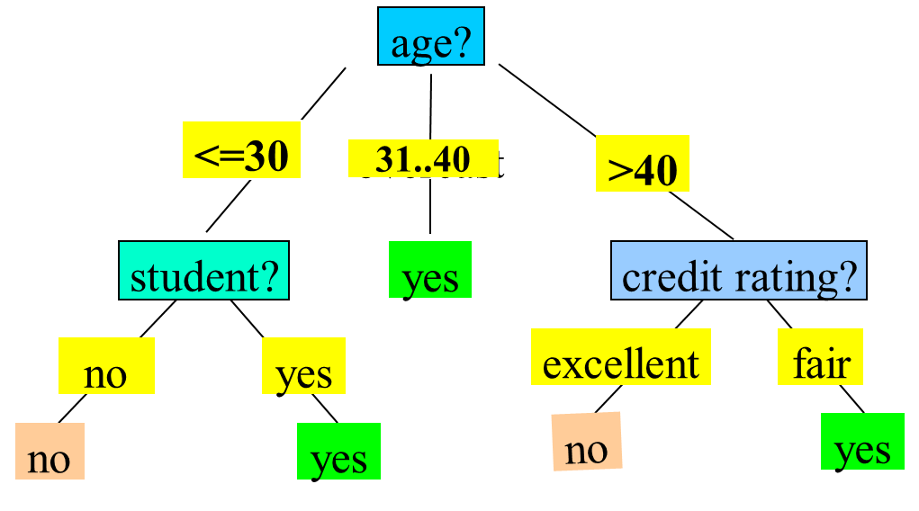
Classification : Decision Tree

Slide 3
Classification : Decision Tree
Basic algorithm (a greedy algorithm):
Tree is constructed in a top-down recursive divide-and-conquer manner
At start, all the training examples are at the root
Attributes are categorical (if continuous-valued, they are discretized in advance)
Examples are partitioned recursively based on selected attributes
Test attributes are selected based on a heuristic or statistical measure (e.g., information gain)

Slide 4
Classification : Decision Tree
ID3 (Iterative Dichotomiser 3) is a classic algorithm used to construct a Decision Tree, primarily for classification tasks. It was developed by Ross Quinlan and serves as one of the earliest algorithms in Decision Tree-based models.
ID3 aims to create a Decision Tree by selecting the most significant feature at each step that best separates the data for classification.
It does this by using information gain (based on entropy) as the criterion to determine the best feature to split on.
Conditions for stopping partitioning:
All records have the same target class (pure leaf node).
No more features to split on (terminate as a leaf node).
Reaching a specified maximum depth or minimum samples threshold to prevent overfitting.

Slide 5
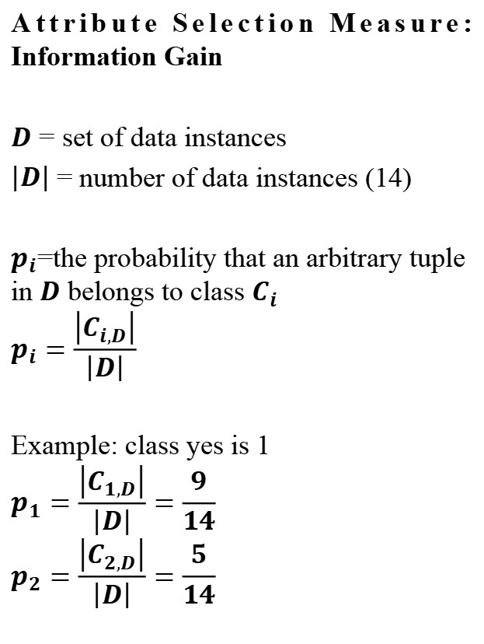
Classification : Decision Tree
Attribute Selection Measure: Information Gain
$D$ = set of data instances
$\left|D\right|$ = number of data instances (14)
$p_{i}$=the probability that an arbitrary tuple in $D$ belongs to class $C_{i}$
$$p_{i}=\frac{\left|C_{i,D}\right|}{\left|D\right|}$$
Example: class yes is 1
$$p_{1}=\frac{\left|C_{1,D}\right|}{\left|D\right|}=\frac{9}{14}$$
$$p_{2}=\frac{\left|C_{2,D}\right|}{\left|D\right|}=\frac{5}{14}$$

Slide 6
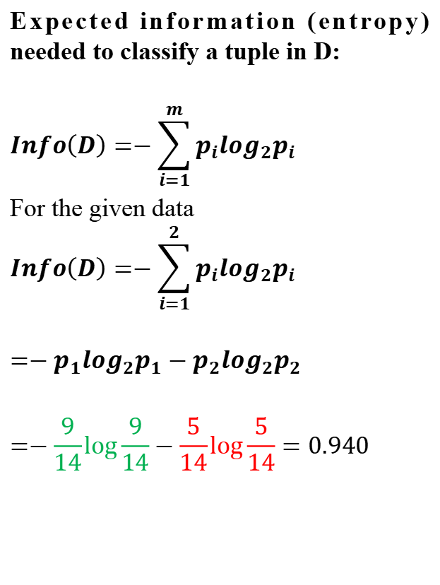
Classification : Decision Tree
Expected information (entropy) needed to classify a tuple in D:
$$Info\left(D\right)=−\sum_{i=1}^{m}{p_{i}\log_{2}p_{i}}$$
For the given data
$$Info\left(D\right)=−\sum_{i=1}^{2}{p_{i}\log_{2}p_{i}}$$
$${=−p}_{1}\log_{2}p_{1}−p_{2}\log_{2}p_{2}$$
$$=−\frac{9}{14}\log{\frac{9}{14}}−\frac{5}{14}\log{\frac{5}{14}}=0.940$$

Slide 7
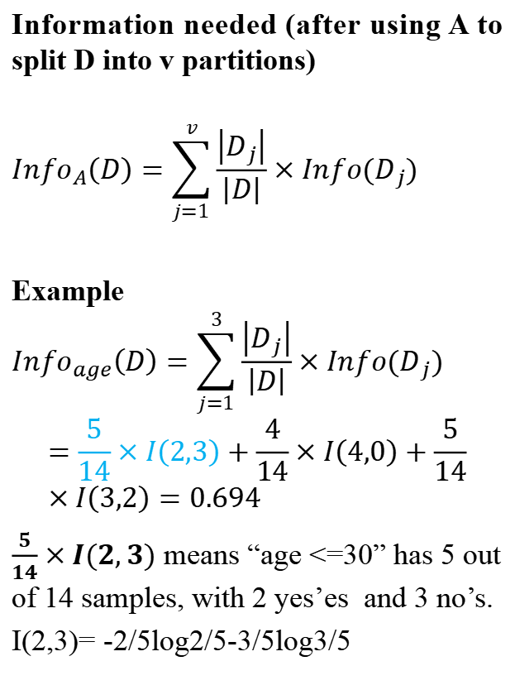
Classification : Decision Tree
Information needed (after using A to split D into v partitions)
$${Info}_{A}\left(D\right)=\sum_{j=1}^{v}{\frac{\left|D_{j}\right|}{\left|D\right|}}×Info(D_{j})$$
Example
$${Info}_{age}\left(D\right)=\sum_{j=1}^{3}{\frac{\left|D_{j}\right|}{\left|D\right|}}×Info(D_{j})$$
$$=\frac{5}{14}×I\left(2,3\right)+\frac{4}{14}×I\left(4,0\right)+\frac{5}{14}×I\left(3,2\right)=0.694$$
$\frac{5}{14}×I(2,3)$ means “age <=30” has 5 out of 14 samples, with 2 yes’es and 3 no’s.
I(2,3)= -2/5log2/5-3/5log3/5

Slide 8
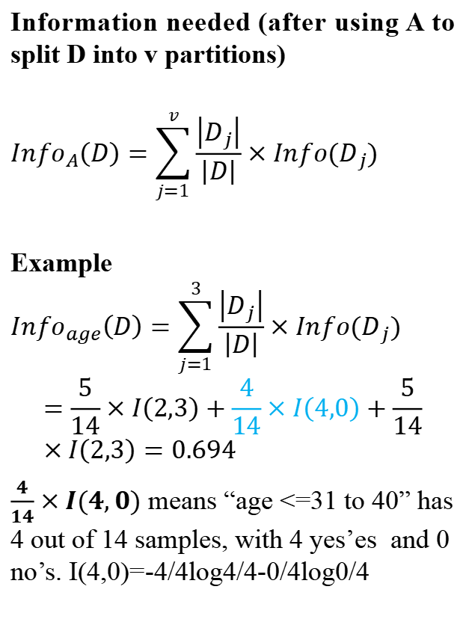
Classification : Decision Tree
Information needed (after using A to split D into v partitions)
$${Info}_{A}\left(D\right)=\sum_{j=1}^{v}{\frac{\left|D_{j}\right|}{\left|D\right|}}×Info(D_{j})$$
Example
$${Info}_{age}\left(D\right)=\sum_{j=1}^{3}{\frac{\left|D_{j}\right|}{\left|D\right|}}×Info(D_{j})$$
$$=\frac{5}{14}×I\left(2,3\right)+\frac{4}{14}×I\left(4,0\right)+\frac{5}{14}×I\left(2,3\right)=0.694$$
$\frac{4}{14}×I(4,0)$ means “age <=31 to 40” has 4 out of 14 samples, with 4 yes’es and 0 no’s. I(4,0)=-4/4log4/4-0/4log0/4

Slide 9
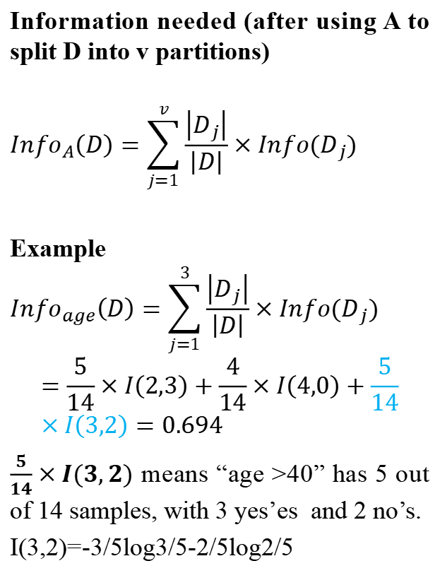
Classification : Decision Tree
Information needed (after using A to split D into v partitions)
$${Info}_{A}\left(D\right)=\sum_{j=1}^{v}{\frac{\left|D_{j}\right|}{\left|D\right|}}×Info(D_{j})$$
Example
$${Info}_{age}\left(D\right)=\sum_{j=1}^{3}{\frac{\left|D_{j}\right|}{\left|D\right|}}×Info(D_{j})$$
$$=\frac{5}{14}×I\left(2,3\right)+\frac{4}{14}×I\left(4,0\right)+\frac{5}{14}×I\left(3,2\right)=0.694$$
$\frac{5}{14}×I(3,2)$ means “age >40” has 5 out of 14 samples, with 3 yes’es and 2 no’s.
I(3,2)=-3/5log3/5-2/5log2/5

Slide 10
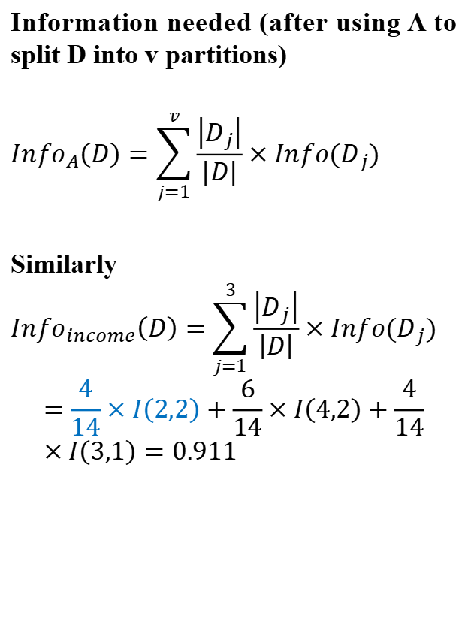
Classification : Decision Tree
Information needed (after using A to split D into v partitions)
$${Info}_{A}\left(D\right)=\sum_{j=1}^{v}{\frac{\left|D_{j}\right|}{\left|D\right|}}×Info(D_{j})$$
Similarly
$${Info}_{income}\left(D\right)=\sum_{j=1}^{3}{\frac{\left|D_{j}\right|}{\left|D\right|}}×Info(D_{j})$$
$$=\frac{4}{14}×I\left(2,2\right)+\frac{6}{14}×I\left(4,2\right)+\frac{4}{14}×I\left(3,1\right)=0.911$$

Slide 11
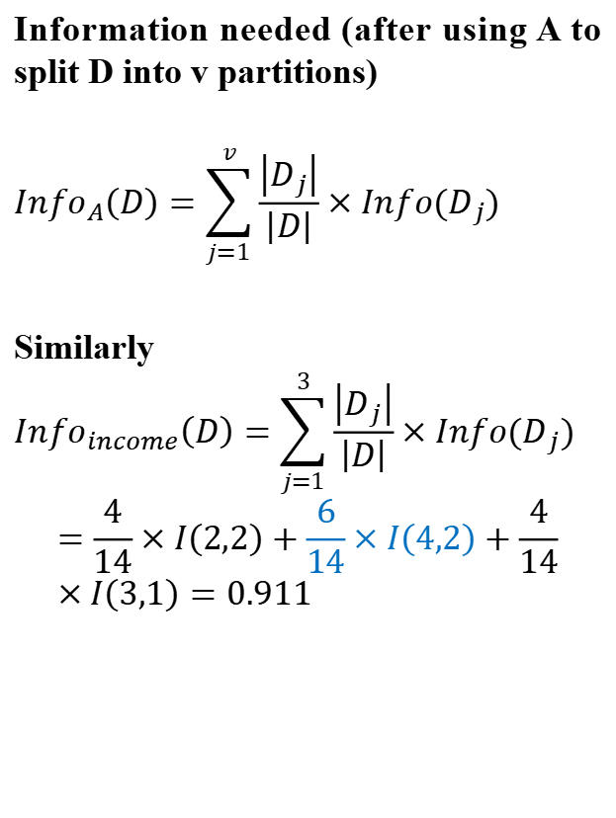
Classification : Decision Tree
Information needed (after using A to split D into v partitions)
$${Info}_{A}\left(D\right)=\sum_{j=1}^{v}{\frac{\left|D_{j}\right|}{\left|D\right|}}×Info(D_{j})$$
Similarly
$${Info}_{income}\left(D\right)=\sum_{j=1}^{3}{\frac{\left|D_{j}\right|}{\left|D\right|}}×Info(D_{j})$$
$$=\frac{4}{14}×I\left(2,2\right)+\frac{6}{14}×I\left(4,2\right)+\frac{4}{14}×I\left(3,1\right)=0.911$$

Slide 12

Classification : Decision Tree
Information needed (after using A to split D into v partitions)
$${Info}_{A}\left(D\right)=\sum_{j=1}^{v}{\frac{\left|D_{j}\right|}{\left|D\right|}}×Info(D_{j})$$
Similarly
$${Info}_{income}\left(D\right)=\sum_{j=1}^{3}{\frac{\left|D_{j}\right|}{\left|D\right|}}×Info(D_{j})$$
$$=\frac{4}{14}×I\left(2,2\right)+\frac{6}{14}×I\left(4,2\right)+\frac{4}{14}×I\left(3,1\right)=0.911$$

Slide 13
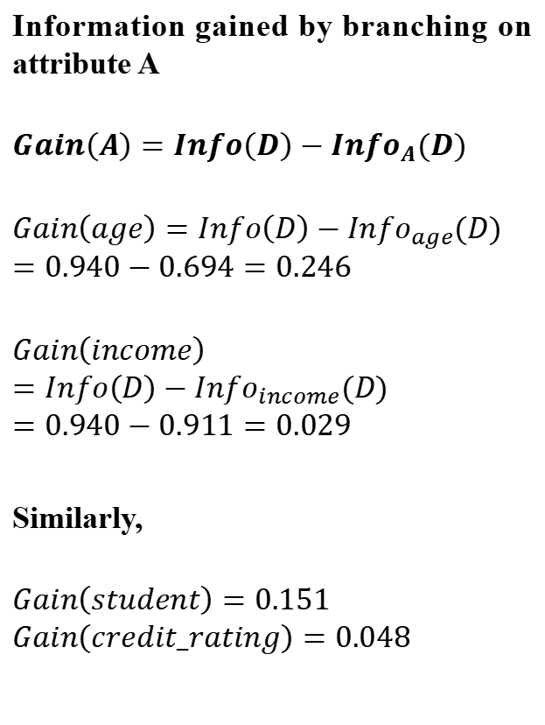
Classification : Decision Tree
Information gained by branching on attribute A
$$Gain\left(A\right)=Info\left(D\right)−{Info}_{A}(D)$$
$$Gain\left(age\right)=Info\left(D\right)−{Info}_{age}(D)$$
$$=0.940−0.694=0.246$$
$$Gain\left(income\right)=Info\left(D\right)−{Info}_{income}(D)$$
$$=0.940−0.911=0.029$$
Similarly,
$$Gain\left(student\right)=0.151$$
$$Gain\left(credit_rating\right)=0.048$$

Slide 14
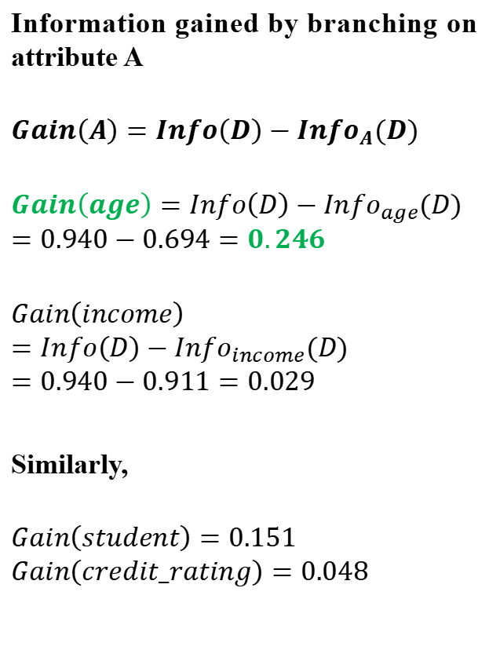
Classification : Decision Tree
Information gained by branching on attribute A
$$Gain\left(A\right)=Info\left(D\right)−{Info}_{A}(D)$$
$$Gain\left(age\right)=Info\left(D\right)−{Info}_{age}(D)$$
$$=0.940−0.694=0.246$$
$$Gain\left(income\right)=Info\left(D\right)−{Info}_{income}(D)$$
$$=0.940−0.911=0.029$$
Similarly,
$$Gain\left(student\right)=0.151$$
$$Gain\left(credit_rating\right)=0.048$$

Slide 15
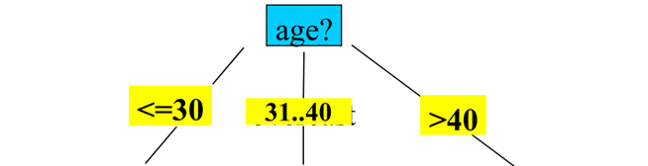
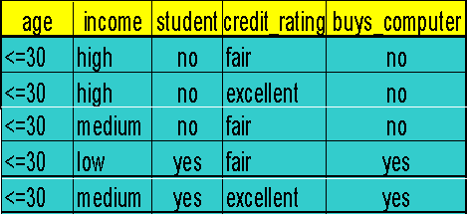
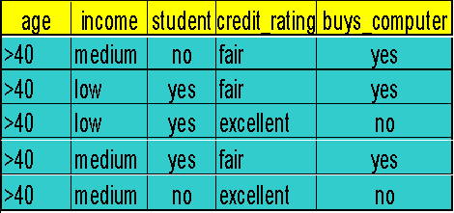
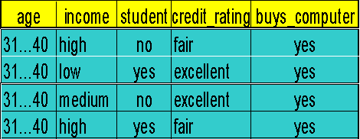
Classification : Decision Tree
Next, repeat the same process with the other nodes with smaller dataset.
So, the first split is on the age attribute

Slide 16
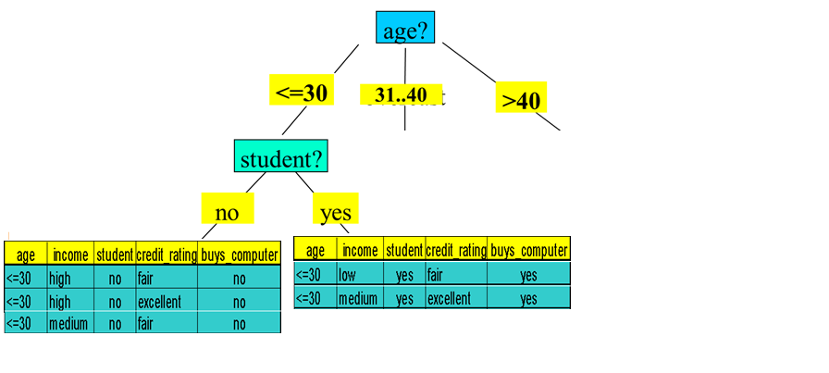
Classification : Decision Tree
Next split is on student at node <=30
All are yes
So, no further split here
All are no
So, no further split here

Slide 17
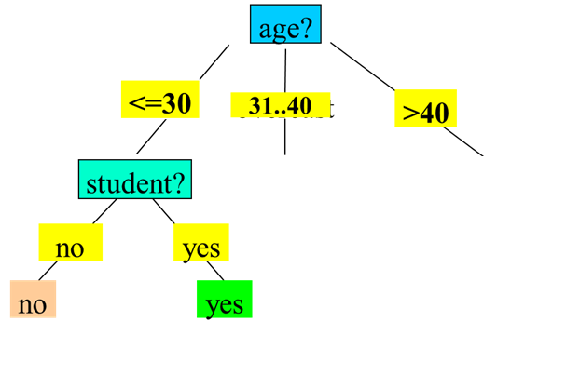
Classification : Decision Tree
No split is required at node 31..40
All are yes
So, no further split here

Slide 18
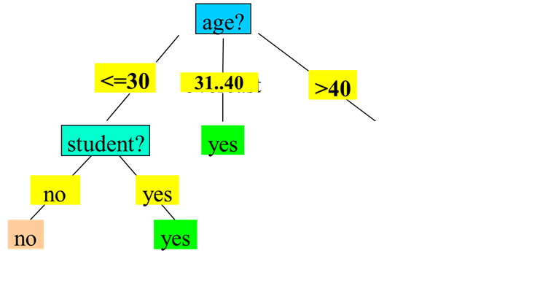
Classification : Decision Tree

Slide 19
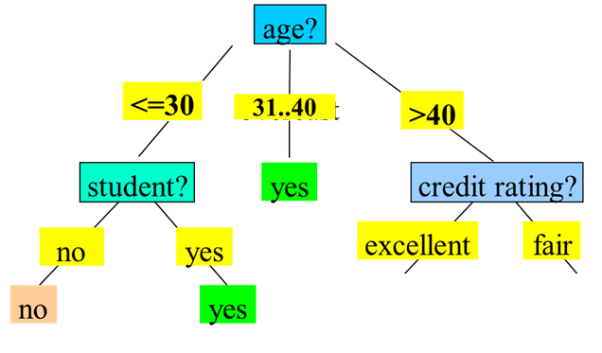

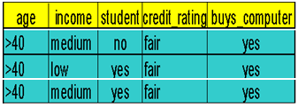
Classification : Decision Tree
Next split is on credit_rating at node >40

Slide 20
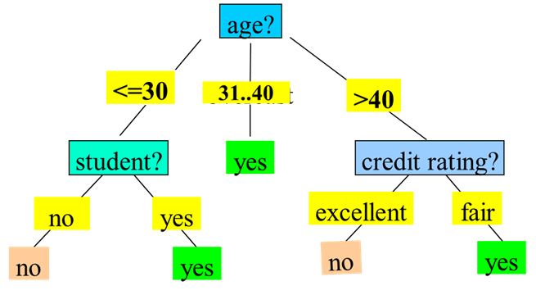
Classification : Decision Tree

Slide 21
Classification : Decision Tree
Classify a new instance
(age: <=30, income: low, student: yes, credit_rating: fair) = buys_computer?

Slide 22
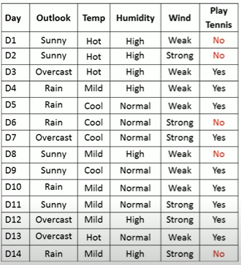
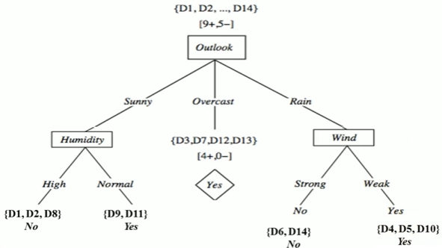
Classification : Decision Tree
Exercise

Slide 23
Classification : Decision Tree
https://colab.research.google.com/drive/1YsHFA55DZ5iQBNq7S11qoS-_WVYtxUYH?usp=sharing

Slide 24
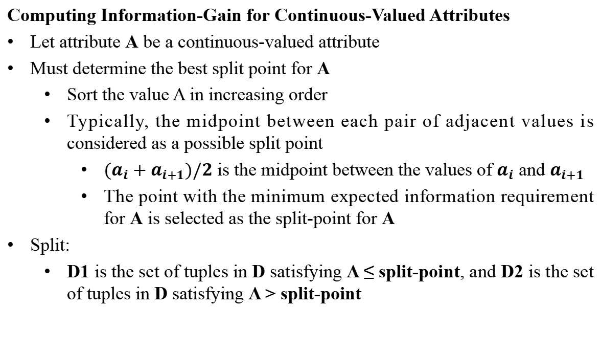
Classification : Decision Tree
Computing Information-Gain for Continuous-Valued Attributes
Let attribute A be a continuous-valued attribute
Must determine the best split point for A
Sort the value A in increasing order
Typically, the midpoint between each pair of adjacent values is considered as a possible split point
${(a}_{i}+a_{i+1})/2$ is the midpoint between the values of $a_{i}$ and $a_{i+1}$
The point with the minimum expected information requirement for A is selected as the split-point for A
Split:
D1 is the set of tuples in D satisfying A ≤ split-point, and D2 is the set of tuples in D satisfying A > split-point

Slide 25
Classification : Decision Tree
Gain Ratio for Attribute Selection (C4.5)
Information gain measure is biased towards attributes with many values
C4.5 (a successor of ID3) uses gain ratio to overcome the problem (normalization to information gain)
GainRatio(A) = Gain(A)/SplitInfo(A)
gain_ratio(income) = 0.029/1.557 = 0.019

Slide 26
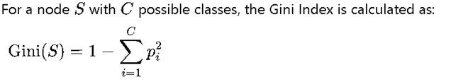
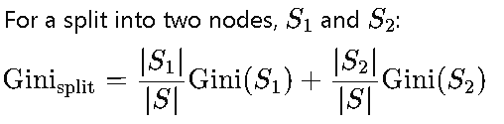
Classification : Decision Tree
Gini Index (CART-Classification and Regression Trees)
Information Gain and Gain Ratio can sometimes exhibit a bias toward features with many unique values. For example, if a feature has many unique categories, Information Gain might prefer it because it creates more distinct subsets.
To address this, Gain Ratio (an adaptation of Information Gain) is used in algorithms like C4.5 to counter this bias, but this additional step adds complexity.
Gini Index, on the other hand, is less sensitive to the number of categories in a feature, reducing the need for an additional adjustment like Gain Ratio.

Slide 27
Classification : Decision Tree
Overfitting in Decision Trees
Overfitting happens when a Decision Tree model becomes too complex, fitting too closely to the noise and specific details of the training data, resulting in poor generalization to new data.
Signs of Overfitting: A decision tree that overfits will often have a high accuracy on the training set but performs poorly on the test set.
Causes of Overfitting:
Allowing the tree to grow too deep, with many nodes and branches.
Having very specific branches (splits) that capture the peculiarities of the training data rather than general patterns.
Consequences: Overfitting leads to a lack of model generalization, where the model captures random fluctuations instead of meaningful trends.

Slide 28
Classification : Decision Tree
Pre-Pruning (Early Stopping):
This approach stops the tree from growing once it meets certain conditions, such as reaching a maximum depth, minimum number of samples per leaf, or minimum information gain threshold. This prevents the tree from developing complex branches that might lead to overfitting.
Meaning that the pre-pruning stops the growth early when further splitting does not improve the model significantly.
Why Pre-Pruning Is Needed
Decision trees tend to overfit if grown to their full depth, capturing even small fluctuations or noise in the training data. This results in:
Low bias but high variance.
Poor generalization on unseen data.
Pre-pruning introduces stopping conditions to control tree growth and maintain a balance between bias and variance.

Slide 29
Classification : Decision Tree
How Pre-Pruning Works
During tree construction, the algorithm evaluates whether splitting a node improves the model’s performance enough to justify the added complexity. If not, the split is not performed, and the node becomes a leaf.
Common stopping criteria used for pre-pruning include:
Criterion | Description
Minimum Information Gain / Gini Decrease | Stop if the reduction in impurity (entropy, Gini index, etc.) after splitting is below a certain threshold.
Maximum Tree Depth | Stop if the tree reaches a user-specified depth (e.g., 5 levels).
Minimum Samples per Split | Stop if a node has fewer than a certain number of samples required to perform a split (e.g., 10).
Minimum Samples per Leaf | Stop if the resulting leaf nodes would contain fewer samples than a set threshold.
Chi-Square Test | Stop if the statistical significance of a potential split is too low (used in some algorithms like CHAID).
Validation Accuracy Check | Stop if splitting does not improve performance on a validation dataset.

Slide 30
Classification : Decision Tree
Pre-Pruning Example
Suppose a node has 100 training samples, and you’re using information gain as your splitting criterion:
The algorithm evaluates all possible splits.
If none of them produces an information gain greater than a small threshold (say, 0.01), it decides not to split further — that node becomes a leaf.

Slide 31
Classification : Decision Tree
Advantages of Pre-Pruning
✅ Reduces overfitting
✅ Speeds up the training process (smaller trees)
✅ Produces more interpretable models
✅ Requires less memory and computation

Slide 32
Classification : Decision Tree
Disadvantages of Pre-Pruning
❌ Might stop too early, missing potentially useful splits that could improve accuracy later
❌ Choosing appropriate thresholds for stopping is non-trivial
❌ Less flexible than post-pruning — once stopped, the split cannot be recovered

Slide 33
Classification : Decision Tree
Post-Pruning (Cost Complexity Pruning):
This technique first grows the tree to its full depth, then prunes back branches that provide minimal value.
Post-pruning can be based on measures like cross-validation to determine the optimal structure that minimizes errors on new data.
This helps in reducing overfitting, improving interpretability, and enhancing model performance on test data.

Slide 34
Classification : Decision Tree
Why Post-Pruning Is Needed
When a decision tree is grown to its maximum depth:
It often becomes too specific to the training data.
It may memorize noise and outliers.
This leads to high variance and poor performance on unseen data.
Post-pruning addresses this by trimming unimportant branches, producing a simpler, more generalizable tree.

Slide 35
Classification : Decision Tree
How Post-Pruning Works
Post-pruning involves two main stages:
Stage 1: Grow the Full Tree
The algorithm first builds a fully expanded tree without applying stopping conditions.
This ensures that all possible splits are considered.
Stage 2: Prune the Tree
Then, starting from the leaf nodes upward, the algorithm removes (or prunes) branches that provide little to no improvement to model performance.
The decision to prune is based on a cost-complexity trade-off: balancing tree size and accuracy.

Slide 36
Classification : Decision Tree
Example (Intuitive Explanation)
Imagine a fully grown decision tree classifying spam emails:
Some deep branches might classify very specific word combinations that appear in only one or two emails.
Post-pruning will evaluate whether removing those deep branches increases or decreases validation accuracy.
If removing them does not hurt (or even improves) performance, they are pruned.
The result is a smaller, more robust decision tree that focuses on the most significant patterns.

Slide 37
Classification : Decision Tree
Advantages of Post-Pruning
✅ Reduces overfitting and improves generalization.
✅ Produces simpler, more interpretable trees.
✅ Allows the model to initially learn all patterns, then eliminate noise-based branches.
✅ Data-driven pruning based on validation results ensures optimal balance.

Slide 38
Classification : Decision Tree
Disadvantages of Post-Pruning
❌ Requires extra computation, as pruning involves re-evaluating subtrees.
❌ Needs a validation set or cross-validation for effectiveness.
❌ Can be time-consuming for very large trees.

Slide 39
Classification : Decision Tree
Aspect | Pre-Pruning | Post-Pruning
Timing | Stops tree growth early | Grows full tree first, then prunes
Computation | Less expensive | More computationally costly
Control | Prevents overfitting early | Corrects overfitting after it occurs
Risk | May underfit | More accurate but slower

Slide 40
Classification : Decision Tree
Thank you

